Slide 1
Text Classification and Naive Bayes
The Task of Text Classification
Notes:
In this lecture we define the Naive Bayes classifier, a basic text classifier that will allow us to introduce many of the fundamental issues in text classification.

Slide 2
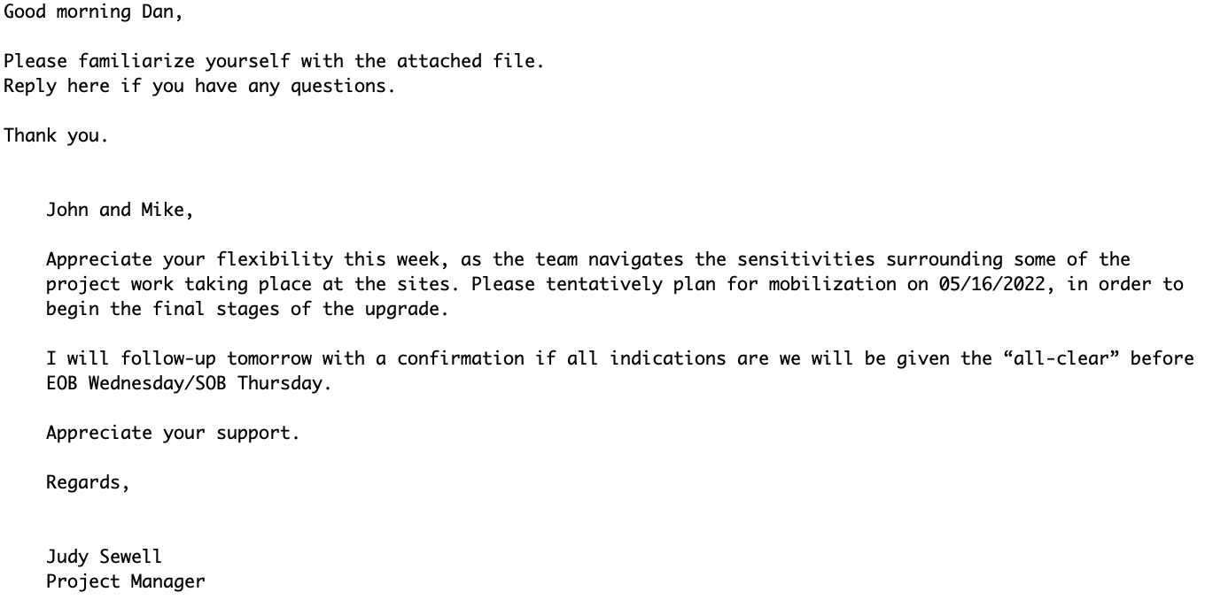
Is this spam?

Slide 3
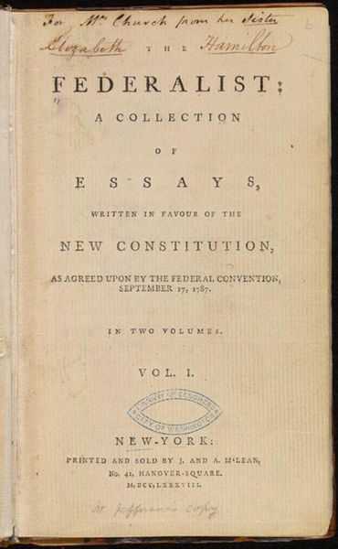
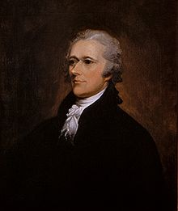
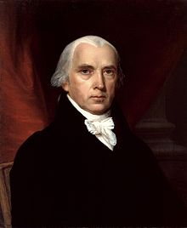
Who wrote which Federalist Papers?
1787-8: essays anonymously written by:
Alexander Hamilton, James Madison, and John Jay
to convince New York to ratify U.S Constitution
Authorship of 12 of the letters unclear between:
1963: solved by Mosteller and Wallace using Bayesian methods
Alexander Hamilton
James Madison

Slide 4


Positive or negative movie review?
unbelievably disappointing
Full of zany characters and richly applied satire, and some great plot twists
this is the greatest screwball comedy ever filmed
It was pathetic. The worst part about it was the boxing scenes.

Slide 5
What is the subject of this article?
MEDLINE Article
MeSH Subject Category Hierarchy
Antogonists and Inhibitors
Blood Supply
Chemistry
Drug Therapy
Embryology
Epidemiology
…
?

Slide 6
Text Classification
Assigning subject categories, topics, or genres
Spam detection
Authorship identification (who wrote this?)
Language Identification (is this Portuguese?)
Sentiment analysis
…

Slide 7
Text Classification: definition
Input:
a document d
a fixed set of classes C = {c₁, c₂,…, c_{J}}
Output: a predicted class c ∈ C

Slide 8
Basic Classification Method: Hand-coded rules
Rules based on combinations of words or other features
spam: black-list-address OR (“dollars” AND “have been selected”)
Accuracy can be high
In very specific domains
If rules are carefully refined by experts
But:
building and maintaining rules is expensive
they are too literal and specific: "high-precision, low-recall"

Slide 9
Classification Method: Supervised Machine Learning
Input:
a document d
a fixed set of classes C = {c₁, c₂,…, c_{J}}
A training set of m hand-labeled documents (d₁,c₁),....,(d_{m},c_{m})
Output:
a learned classifier γ:d → c

Slide 10
Classification Methods: Supervised Machine Learning
Many kinds of classifiers!
Naïve Bayes (this lecture)
Logistic regression
Neural networks
k-nearest neighbors
…
We can also use pretrained large language models!
Fine-tuned as classifiers
Prompted to give a classification

Slide 11
Text Classification and Naive Bayes
The Naive Bayes Classifier
Notes:
In this lecture we define the Naive Bayes classifier, a basic text classifier that will allow us to introduce many of the fundamental issues in text classification.

Slide 12
Naive Bayes Intuition
Simple ("naive") classification method based on Bayes rule
Relies on very simple representation of document
Bag of words

Slide 13
The Bag of Words Representation

Slide 14
The bag of words representation
seen | 2
sweet | 1
whimsical | 1
recommend | 1
happy | 1
... | ...
γ(
)=c

Slide 15
Bayes’ Rule Applied to Documents and Classes
For a document d and a class c

Slide 16
Naive Bayes Classifier (I)
MAP is “maximum a posteriori” = most likely class
Bayes Rule
Dropping the denominator

Slide 17
Naive Bayes Classifier (II)
"Likelihood"
"Prior"
Document d represented as features x1..xn

Slide 18
Naïve Bayes Classifier (IV)
O(|X|^{n}•|C|) parameters
How often does this class occur?
Could only be estimated if a very, very large number of training examples was available.
We can just count the relative frequencies in a corpus

Slide 19
Multinomial Naive Bayes Independence Assumptions
Bag of Words assumption: Assume position doesn’t matter
Conditional Independence: Assume the feature probabilities P(x_{i}|c_{j}) are independent given the class c.

Slide 20
Multinomial Naive Bayes Classifier

Slide 21
Applying Multinomial Naive Bayes Classifiers to Text Classification
positions ← all word positions in test document

Slide 22
Problems with multiplying lots of probs
There's a problem with this:
Multiplying lots of probabilities can result in floating-point underflow!
.0006 * .0007 * .0009 * .01 * .5 * .000008….
Idea: Use logs, because log(ab) = log(a) + log(b)
We'll sum logs of probabilities instead of multiplying probabilities!

Slide 23
We actually do everything in log space
Instead of this:
This:
Notes:
1) Taking log doesn't change the ranking of classes!
The class with highest probability also has highest log probability!
2) It's a linear model:
Just a max of a sum of weights: a linear function of the inputs
So naive bayes is a linear classifier

Slide 24
Text Classification and Naive Bayes
The Naive Bayes Classifier
Notes:
We've now seen the basic principles of naïve bayes classification!

Slide 25
Text Classification and Naïve Bayes
Naive Bayes: Learning

Slide 26
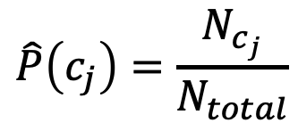
Learning the Multinomial Naive Bayes Model
Sec.13.3
First attempt: maximum likelihood estimates
simply use the frequencies in the data
$$\hat{P}\left(c_{j}\right)=\frac{N_{c_{j}}}{N_{total}}$$

Slide 27
Parameter estimation
fraction of times word w_{i} appears
among all words in documents of topic c_{j}
Create mega-document for topic j by concatenating all docs in this topic
Use frequency of w in mega-document

Slide 28
Problem with Maximum Likelihood
Sec.13.3
What if we have seen no training documents with the word fantastic and classified in the topic positive (thumbs-up)?
Zero probabilities cannot be conditioned away, no matter the other evidence!

Slide 29
Laplace (add-1) smoothing for Naïve Bayes

Slide 30
Multinomial Naïve Bayes: Learning
From training corpus, extract Vocabulary
Calculate P(c_{j}) terms
For each c_{j} in C do
docs_{j} ← all docs with class =c_{j}
Calculate P(w_{k} | c_{j}) terms
Text_{j} ← single doc containing all docs_{j}
For each word w_{k} in Vocabulary
n_{k} ← # of occurrences of w_{k} in Text_{j}

Slide 31
Unknown words
What about unknown words
that appear in our test data
but not in our training data or vocabulary?
We ignore them
Remove them from the test document!
Pretend they weren't there!
Don't include any probability for them at all!
Why don't we build an unknown word model?
It doesn't help: knowing which class has more unknown words is not generally helpful!

Slide 32
Stop words
Some systems ignore stop words
Stop words: very frequent words like the and a.
Sort the vocabulary by word frequency in training set
Call the top 10 or 50 words the stopword list.
Remove all stop words from both training and test sets
As if they were never there!
But removing stop words doesn't usually help
So in practice most NB algorithms use all words and don't use stopword lists

Slide 33
Text Classification and Naive Bayes
Naive Bayes: Learning

Slide 34
Text Classification and Naive Bayes
Sentiment and Binary Naive Bayes
Notes:
In this lecture we'll do a worked example of naïve bayes sentiment analysis, and also introduce the binary multinominal naïve bayes algorithm.

Slide 35
Let's do a worked sentiment example!

Slide 36
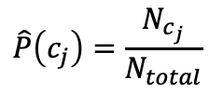

A worked sentiment example with add-1 smoothing
1. Prior from training:
$$\hat{P}\left(c_{j}\right)=\frac{N_{c_{j}}}{N_{total}}$$
P(-) = 3/5
P(+) = 2/5
2. Drop "with"
3. Likelihoods from training:
$$p\left(w_{i} | c\right)= \frac{count\left(w_{i},c\right)+1}{\left(\sum_{w∈V}{count\left(w,c\right)}\right)+|V|}$$
4. Scoring the test set:

Slide 37
Optimizing for sentiment analysis
For tasks like sentiment, word occurrence seems to be more important than word frequency.
The occurrence of the word fantastic tells us a lot
The fact that it occurs 5 times may not tell us much more.
Binary multinominal naive bayes, or binary NB
Clip our word counts at 1
Note: this is different than Bernoulli naive bayes; see the textbook at the end of the chapter.

Slide 38
Binary Multinomial Naïve Bayes: Learning
From training corpus, extract Vocabulary
Calculate P(c_{j}) terms
For each c_{j} in C do
docs_{j} ← all docs with class =c_{j}
Calculate P(w_{k} | c_{j}) terms
Text_{j} ← single doc containing all docs_{j}
For each word w_{k} in Vocabulary
n_{k} ← # of occurrences of w_{k} in Text_{j}
Remove duplicates in each doc:
For each word type w in doc_{j}
Retain only a single instance of w

Slide 39
Binary Multinomial Naive Bayes on a test document d
First remove all duplicate words from d
Then compute NB using the same equation:

Slide 40
Binary multinominal naive Bayes

Slide 41
Binary multinominal naive Bayes

Slide 42
Binary multinominal naive Bayes

Slide 43
Binary multinominal naive Bayes
Counts can still be 2! Binarization is within-doc!

